Slide 1
Real Time System
Airbag & Pacemaker System
By : Mohammad Aiman Naufal bin Abd Rahim

Slide 2
01
TABLE OF CONTENTS
02
03
04
ABOUT KOE
INTRO TO RTS
AIRBAG
PACEMAKER

Slide 3
ABOUT KOE

Slide 4
PROGRAMMES
MANUFACTURING
ELECTRONICS @
COMPUTER & INFORMATION
To study the properties of materials as they are altered and influenced by processing
To acquire a comprehensive foundation in computer engineering, with subjects on both hardware and software
CIVIL
MATERIALS
Design, construction, maintenance and the operation of infrastructure
To study the properties of materials and its value in every application

Slide 5
PROGRAMMES
BIOCHEMICAL - BIOTECHNOLOGY
MECHANICAL - AUTOMOTIVE
To solve animate and inanimate problems in Biochemical Engineering with emphasis in Biotechnology
To study the design and analysis of mechanical and automotive vehicles
AEROSPACE
MECHATRONICS
To the design and analysis of aerospace vehicles
To study the control and instrumentation for robotics and automation and also mechatronics systems design

Slide 6
INTRO TO RTS

Slide 7
The system is subjected to real time
To run application with very precise timing and a high degree of reliability
Responds to external events in a timely fashion
Does not mean faster performance

Slide 8
HARD vs SOFT
HARD
SOFT
Can meet desired deadlines at all times
Safety is critical
Missing a deadline can have fatal consequences
Can meet desired deadlines on average
Safety is non critical
Can miss a few deadlines without failing the whole system

Slide 9
AIRBAG

Slide 10
COMPONENTS
CRASH SENSOR
AIRBAG INFLATOR
To detect any sudden decceleration while crahing into a solid object
To inflate the airbag in the airbag module

Slide 11
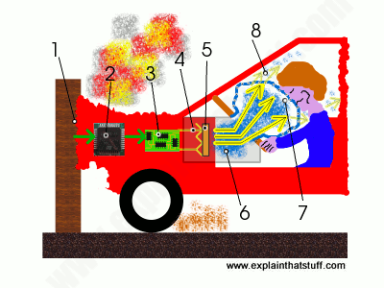
Crash
Crash sensor to detect the force and also deceleration
Airbag circuit is triggered
Electric current pass through towards the heating element
Ignite chemical reaction producing nitrogen gas
Harmless gas produced
Airbag expand
Airbag deflate as the gas escapes through small holes

Slide 12
PACEMAKER
Use low-energy electrical pulses to control the rate and rhythm of your heartbeat

Slide 13
COMPONENTS
PULSE GENERATOR
WIRES
Carry the electrical pulses
Generate electrical pulses
ELECTRODES
Sense natural heartbeat

Slide 14
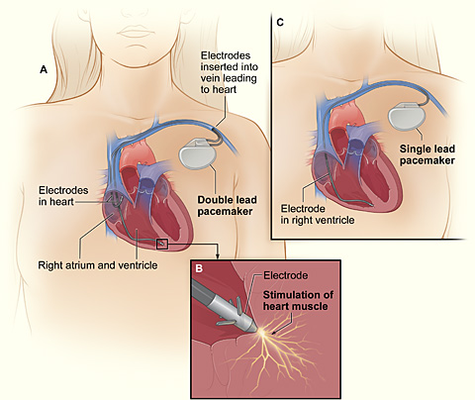

Slide 15
THANKS
Do you have any questions?

